Slide 1
Digital Portfolio
STUDENT NAME: GOPIKA.K
REGISTER NO AND NMID: 222407888
DEPARTMENT: computer science and data science
COLLEGE: COLLEGE/ UNIVERSITY

Slide 2
PROJECT TITLE
DYNAMIC PORTFOLIO WEB APPLICATION USING REACT .js

Slide 3


AGENDA
Problem Statement
Project Overview
End Users
Tools and Technologies
Portfolio design and Layout
Features and Functionality
Results and Screenshots
Conclusion
Github Link
3/21/2024 Annual Review

Slide 4

PROBLEM STATEMENT
In today’s digital age, professionals, students, and freelancers need an effective way to showcase their skills, projects, and achievements online. Traditional resumes and static portfolio websites lack interactivity, real-time updates, and personalization. They often fail to engage potential employers, clients, or collaborators, leading to missed opportunities. There is a need for a dynamic, user-friendly, and customizable portfolio web application that allows individuals to present their work in a modern, responsive, and interactive manner. By leveraging React.js, the application can deliver fast performance, reusable components, seamless navigation, and an engaging user experience.

Slide 5

PROJECT OVERVIEW
The Dynamic Portfolio Web Application using React.js is designed to provide an interactive and customizable platform for showcasing personal and professional achievements. Unlike traditional static portfolio websites, this application enables real-time updates, improved performance, and a seamless user experience by leveraging the component-based architecture of React.js.The application will allow users to present their skills, projects, education, work experience, and contact details in a visually appealing and responsive layout. With a focus on dynamic data handling, users can update their portfolio content (such as adding new projects or editing skills) without modifying the core source code.

Slide 6

WHO ARE THE END USERS?
End UsersThe end users of the Dynamic Portfolio Web Application are:1. Students and Fresh GraduatesWho want to showcase their academic achievements, projects, internships, and skills to potential employers or higher education institutions.2. Job Seekers and ProfessionalsIndividuals looking for employment opportunities who need a professional, dynamic, and interactive portfolio instead of a traditional resume.3. Freelancers and Creatives (Designers, Developers, Writers, Artists, etc.)Who want to present their work samples, client projects, and achievements to attract new clients and build credibility.4. Entrepreneurs and Business OwnersWho may use the portfolio as a personal brand website to showcase their journey, skills, and ventures.5. Recruiters, Employers, and Clients (secondary users)

Slide 7

TOOLS AND TECHNIQUES
1. Development ToolsReact.js → Core library for building the dynamic, component-based portfolio web application.Node.js & npm (Node Package Manager) → For managing dependencies and running the development server.Visual Studio Code (VS Code) → Primary Integrated Development Environment (IDE) for coding.Git & GitHub → Version control and hosting the project repository.2. Frontend TechnologiesHTML5 & CSS3 → For structuring and styling the portfolio.JavaScript (ES6+) → Core scripting language for interactivity and logic.React Router → For smooth navigation across different portfolio pages (Home, About, Projects, Contact).Bootstrap / Tailwind CSS / Material UI → For responsive and modern UI design.3. Backend & Data Handling (Optional if dynamic data is included)Firebase / Node.js with Express / JSON file → To store and fetch portfolio data dynamically (projects, skills, etc.).REST API or GraphQL (optional) → For managing structured data updates.

Slide 8
POTFOLIO DESIGN AND LAYOUT
1. Overall LayoutHeader / Navigation BarFixed at the top for quick navigation.Contains links such as Home, About, Skills, Projects, Contact.Hero Section (Landing Page)A professional introduction with the user’s name, title (e.g., Web Developer / Designer), and a short tagline.A profile picture or creative illustration.A “Download Resume” or “Hire Me” button.About SectionA brief bio describing the user’s background, education, and goals.Option to highlight key strengths.Skills SectionInteractive skill bars, icons, or progress circles to showcase technical and soft skills.
8

Slide 9
FEATURES AND FUNCTIONALITY
1. Core FeaturesDynamic Content ManagementAbility to add, edit, or update portfolio details (projects, skills, bio) without modifying core code.Responsive DesignWorks smoothly across desktop, tablet, and mobile devices.Reusable React ComponentsModular design with components like Navbar, Project Cards, Skill Bars, Contact Form, etc.Single Page Application (SPA)Smooth navigation using React Router without reloading the page.2. Portfolio Sections & Their FunctionalitiesHome (Landing Page)Professional introduction with name, role, tagline, and a call-to-action (e.g., Download Resume / Hire Me).Animated hero section for first impression.About SectionPersonal background, career goals, and short biography.Option to highlight achievements or certifications.Skills SectionInteractive visualization of skills (progress bars, percentage circles, or icons).Categorized into technical skills, soft skills, or tools.

Slide 10
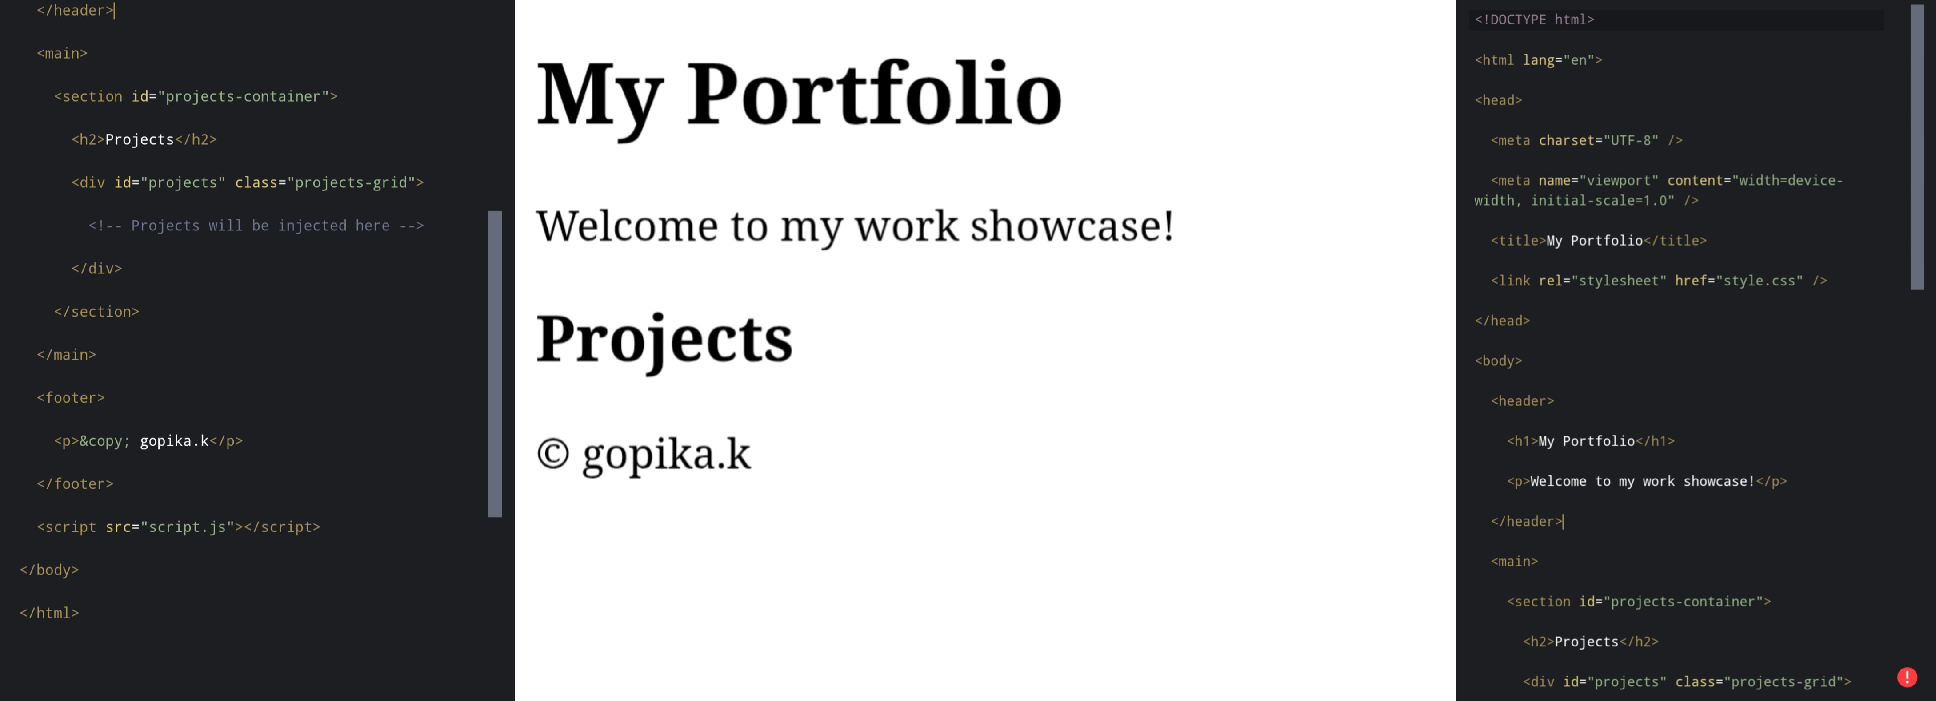

RESULTS AND SCREENSHOTS
3/21/2024 Annual Review
10

Slide 11
CONCLUSION
The Dynamic Portfolio Web Application using React.js successfully addresses the limitations of static resumes and traditional portfolio websites by providing a modern, interactive, and responsive platform for showcasing personal and professional achievements. Through the use of React.js and its component-based architecture, the application ensures reusability, scalability, and efficient performance.This project demonstrates how individuals such as students, professionals, and freelancers can establish a strong digital identity by presenting their skills, projects, and experience in an engaging and user-friendly manner. The portfolio’s dynamic nature allows easy updates without altering the source code, ensuring that the content remains current and relevant.
11

